Slide 1

GANDHINAGAR INSTITUTE OF TECHNOLOGY
Department of Computer Engineering
Academic Year: 2014-2015
Project Name:- APP-MAKER
Presented by:-
Nishit Gopani (110120107039)
Kunjal Trivedi (110120107066)
Team-Id:GIT_CE_14_12
Guided By:-
Prof. Sonali Virparia
Assistant Professor
Computer Engineering Department.

Slide 2
Outline....
Introduction
Purpose
Literature Review
Proposed Solution
Innovative Features
Technology
Modules
System Requirements

Slide 3
Outline(cont..)
Which model is used..?
Software and Hardware Requirement
Gantt Chart
Analysis of system
E-R Diagram
Use case Diagram
Data flow Diagram
Class Diagram
Sequence Diagram
Activity Diagram
Data Dictionary
Screenshots
Conclusion
Future Work
References

Slide 4
Introduction
For many businesses, the logical next step after a website is a mobile app. But, until very recently, developing the mobile application was time-consuming and expensive.
To solve that problem, APP MAKER developed a concept called "Do-it-yourself", mobile-app authoring platform, which lets anyone build their own app, without having to hire coders, programmers, or anyone else.
The application APP-MAKER can make the mobile app of existing web app as well as non existing web app, it creates the mobile app then market it and updates all changes .

Slide 5
Introduction(CONT..)
As millions of consumers today turn to their smartphones and tablets to shop, search, order, and pay, even the smallest businesses need to reach their customers on mobile devices.
The apps are actually universal: app maker's platform creates them in HTML5, a programming language supported by most smartphones.
In addition, the Console keeps track of app activities: It provides businesses with information about how the app is being used, such as which offers the customers are taking advantage of and their favourite feature of the app.

Slide 6
Purpose
The Main purpose behind creating this system is to help the user for creating a mobile application.
One Platform and Multiple OS supported by App-Maker. User can create mobile application in different platforms.

Slide 7
Literature Review
Websites:-
App-builder.com:-This website provides good functionalities such as Style & navigation, report generation, connectivity to Social sites, but it is lacking in Attractive UI
Como.com:- This website provide monetization and coupens but lacking in Pricing plans that are to provide to user for app-creation.
Appery.io.com :- This website provides drag and drop features and many pre defined templates for app-creation but does not provide Qrcode facility.

Slide 8
Proposed Solution
The main drawbacks of existing websites led us to develop a user friendly website App-Maker.
No website offers two platform together for building mobile application.
Most problems would be solved and the expectations of the current users of these sites would be satisfied through App-Maker as it will provide Attractive UI, Best pricing plans, Qrcode and other such exciting and new features.
Thus, as a solution to the problems mentioned above, a website App-Maker is being developed by us

Slide 9
INNOVATION
In existing system ,if we have to make an android app then we have to go to andriod developer ,Similarly for i-phone app we have to go to i-phone developer.
But APP-MAKER over come this disadvantage of existing system ,GOAL of APP-maker is to create an application which makes mobile app of andriod as well iphone on a single platform.
APP-MAKER provides facility to user of NO requirement of CODING and knowledge of any mobile application development
APP-MAKER is so easy that any one can create their own

Slide 10
INNOVATION(CONT..)
Making an app through APP-MAKER is so easy that any one can create their own mobile app without any trouble.
It is USER FRIENDLY
Everything you need to customize and manage your app, engage your users, and grow your business on mobile.

Slide 11
Technology
Programming:-Java
Server Side Technology:-J2EE, Web Service based on JAX-RS
Client Side Technology:-Bootstrap(v-3.3.2), JQuery, JavaScript
Web App Server:- Apache Tomcat 6
Mobile Application Development Framework:-PhoneGap(Apache Cordova)
Mobile Application Client Side Technology:-JQuery mobile, JavaScript
Back-end:-My Sql

Slide 12
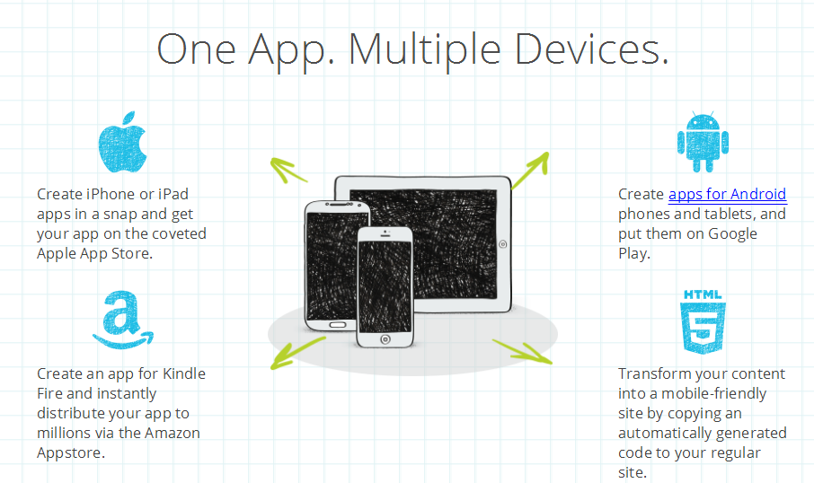

Slide 13
Modules
Admin
User
REGISTERED USER
VISITOR USER

Slide 14
MODULE (ADMIN)
Manage Users(Login and Registration).
Manage Category and Templates.
Manage App-Gallery.
Manage Build Servers.
Manage Platforms.
Manage Plans.
Manage Notifications.
Manage Report Generation.

Slide 15
MODULE (USER)
Register/Login.
Selects Categories and Templates.
View App-Gallery.
Manage Profile.
Plans Selection.
Edit Created App.
View Generated Report.

Slide 16
Functionality
Registration
Login
Create-App
Edit profile
Categories
Select templates
Select plans
Report Generation

Slide 17
Functionality(cont..)
Notification
One Platform multiple-OS
Connectivity to social media

Slide 18
SYSTEM REQUIREMNETS
Hardware requirement for server side for hosting
Web Application server & web service.
Intel Xenon based processor with clock speed at least 2.5 GHz.
8GB DDR RAM.
100GB SATA2 HD with at least 10GB of free storage .
Mactonish server with Intel processor.
Client side
Only browser rendering HTML is enough with an internet connection with at least 512 Kbps and 1024*768 screen resolution.

Slide 19
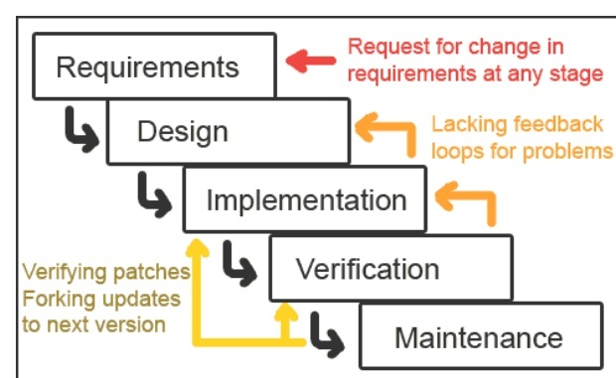
Which model is used?
For APP-MAKER we use iterative waterfall model

Slide 20
Why we use this model?
Oldest software lifecycle model and best understood by upper management
Used when requirements are well understood and risk is low
Work flow is in a linear (i.e., sequential) fashion with backtracking
We use iterative waterfall model because requirement are clear cut and well-defined
This model is easy to understand
Problems can be somewhat alleviated in the model through the addition of feedback loops
We can also use waterfall model but problem with this model is waterfall model is that the linearity of the development results in a failure to provide early feedback on the development

Slide 21
SOFTWARE REQUIRENMENTS
Web Server:-Apache Tomcat
MySQl 5.6
Java Runtime enviroment(JRE-7)
Any server capable of running java
Node js

Slide 22
DEVELOPMENT TOOLS
Eclipse (Kepler)
Phone Gap(Apache Cordova)
JDK 1.7
Notepad++
Web browser
Npm command prompt

Slide 23
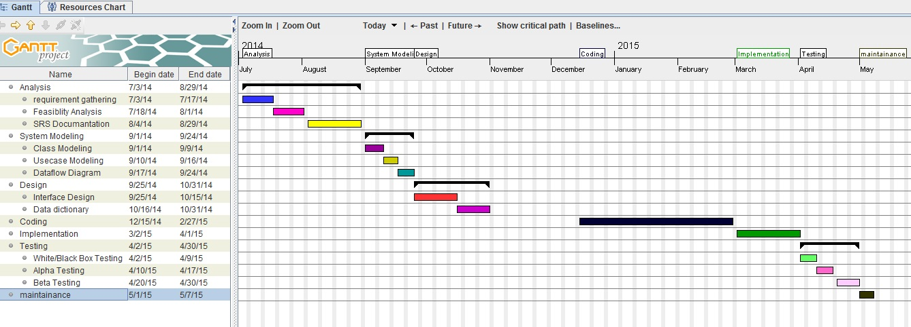
Gantt Chart

Slide 24
Diagrams
Entity Relationship Diagram
Use case Diagram
Data Flow Diagram
Class Diagram
Sequence Diagram
Activity Diagram

Slide 25
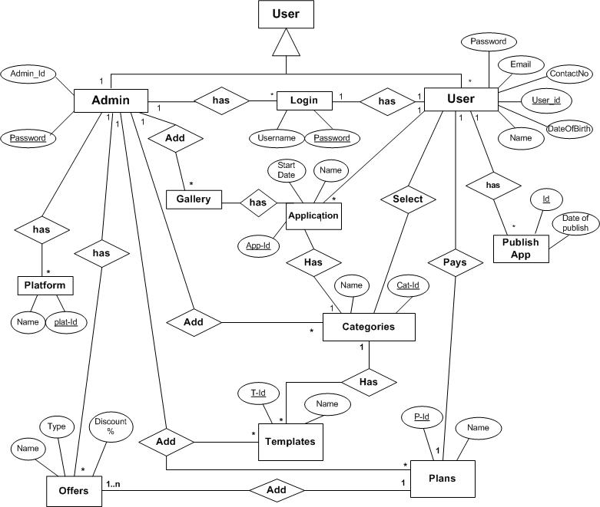
E-R Diagram

Slide 26
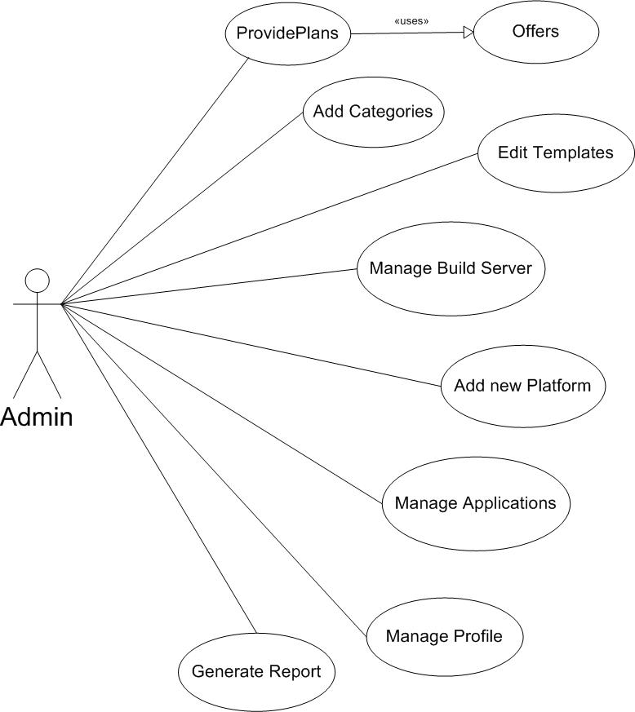
Use Case Diagram for Admin

Slide 27
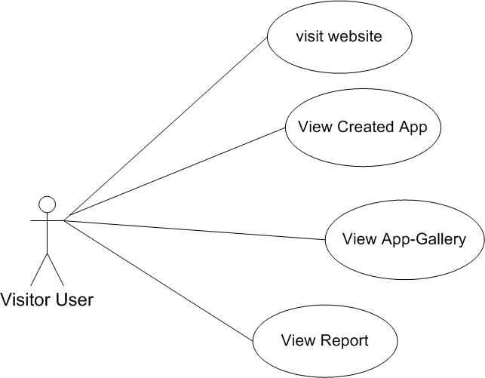
Use Case Diagram for visitor

Slide 28
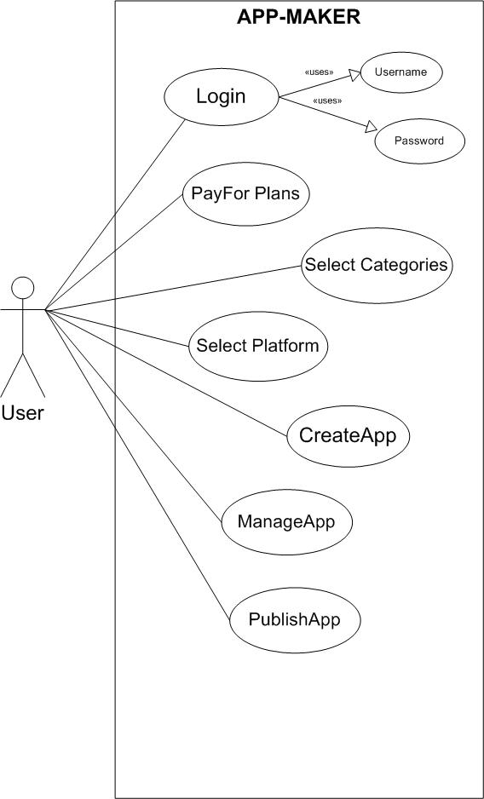
Use Case Diagram for Registered User

Slide 29
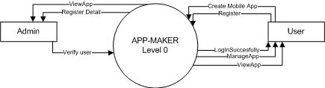
DataFlow Diagram Level-0

Slide 30
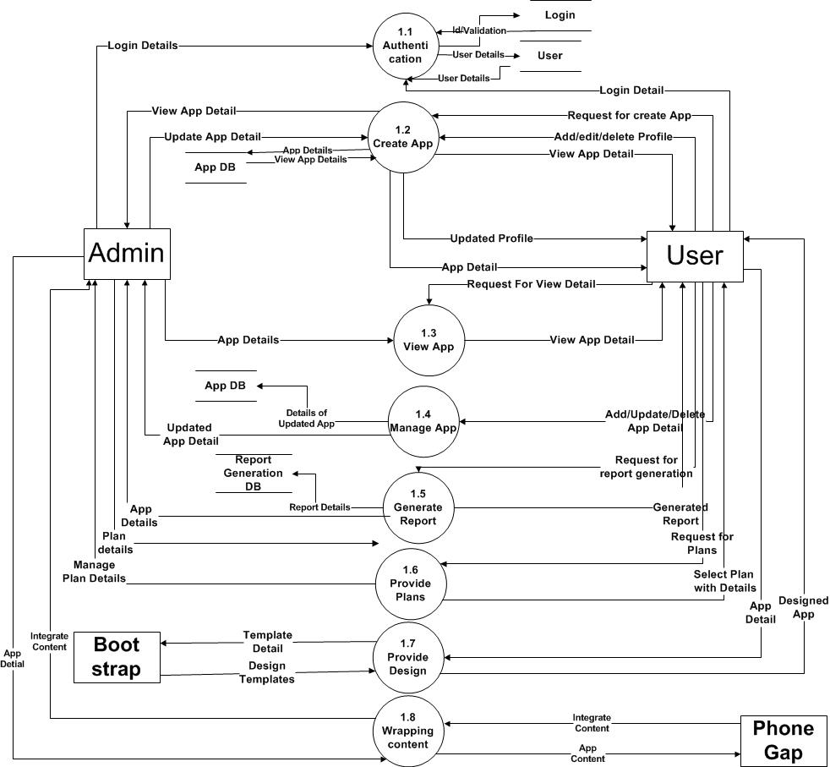
DataFlow Diagram level-1

Slide 31
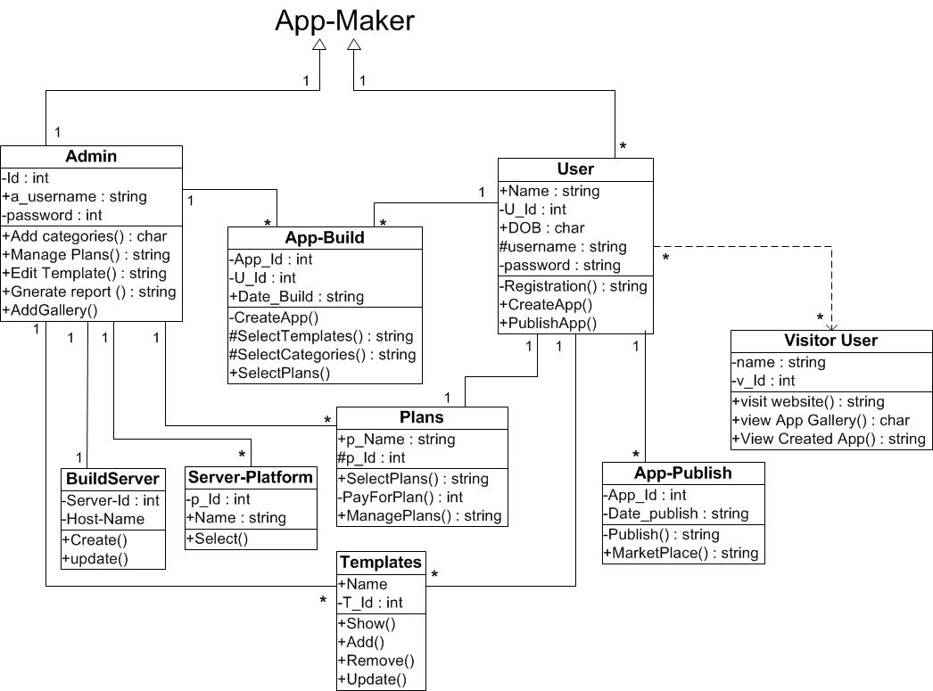
Class Diagram

Slide 32
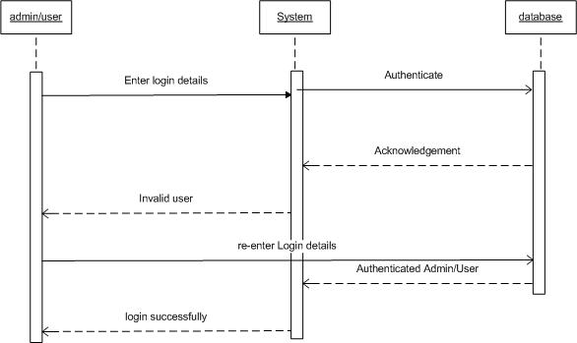
Admin/User Sequence

Slide 33
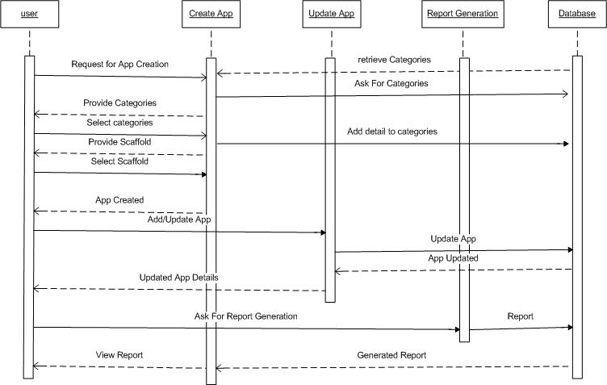
System sequence Diagram

Slide 34
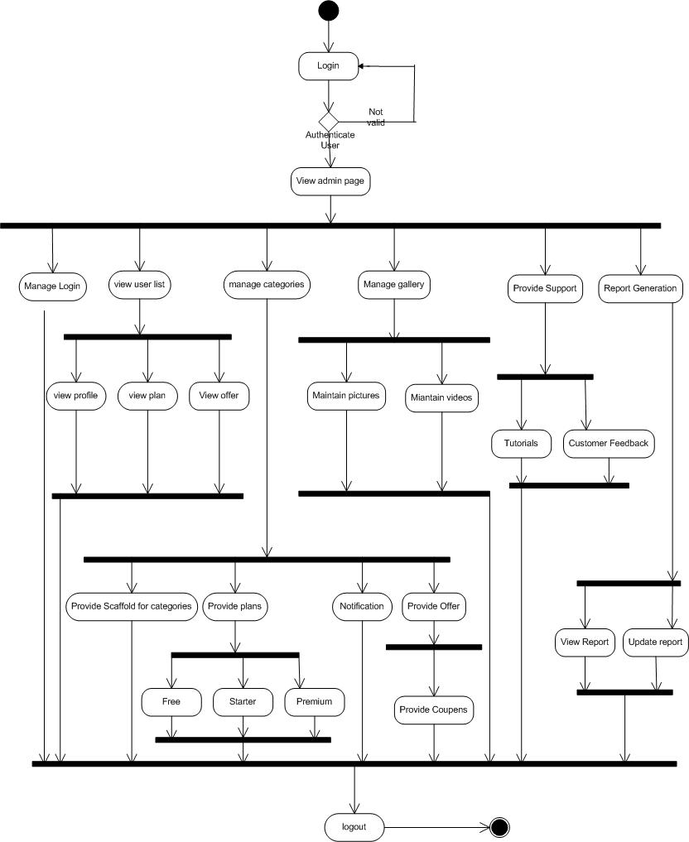
Admin Activity Diagram

Slide 35
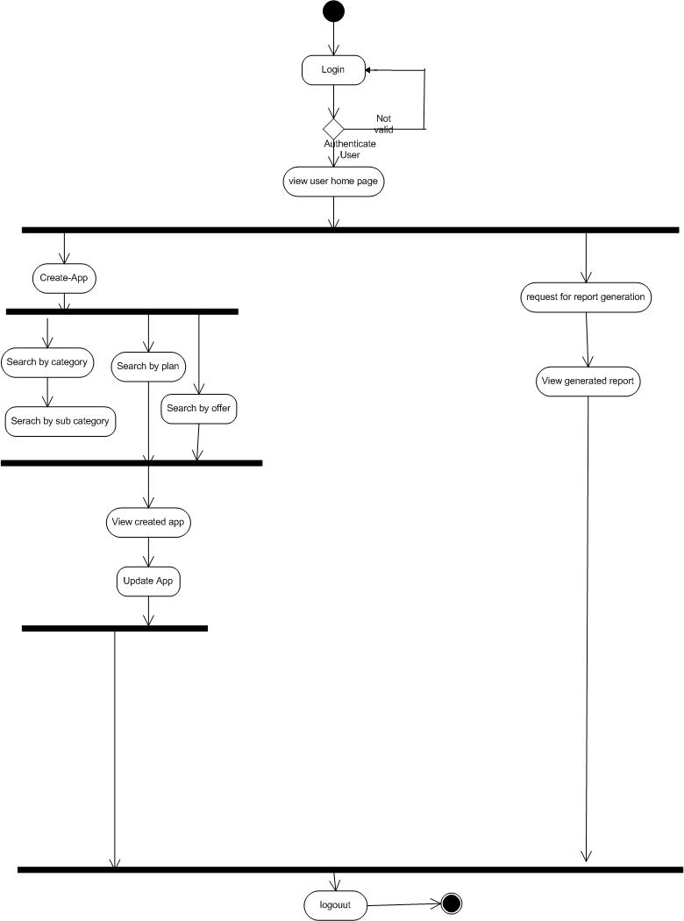
User Activity Diagram

Slide 36

COMPANY PROFILE
Ahmedabad-based Hyperlink Infosystem is believed to be one of the popular providers of IT services.
A Hyperlink Infosystem is specialist in Mobile Application Development. We have expertise in developing mobile applications for different platform and Mobile devices such as Blackberry Mobile Application Development, Windows Mobile Development, iPhone Mobile Apps Development,Android Application Development

Slide 37
COMPANY PROFILE (CONT..)
SERVICES PROVIDED:-
Web designing
Application development
Java development
.Net development
Logo designing
Testing & QA services
E-commerce website and many more…
It is located at:
Ganesh Meredian, Near Sola Bridge, Opp Gujarat High Court, S.G. Highway, AHMEDABAD

Slide 38
DATA DICTIONARY

Slide 39
Sr no | Column | Data Type | Size | Constraints | Description
1 | Id | Number | 10 | Primary key | Assign Unique Id to Offer.
2 | User_Name | Varchar2 | 30 | NOT NULL | Assign Name to User.
3 | Email_Id | Varchar2 | 25 | NOT NULL | Defines unique Email_Id
4 | Password | Password | 25 | Length of password Should contain at least 6 characters. | Define password of the user
5 | Address | Varchar2 | 30 | NOT NULL | Defines the address of the user
6 | Contact_No | Number | 20 | NOT NULL | Defines contact no of user
7 | DoB | Varchar2 | 20 | NOTNULL | Defines date of birth of user
Table 1 User
Sr no | Column | Data Type | Size | Constraints | Description
1 | Category_Id | NUMBER | 11 | Primary Key | Assign Unique Id to categories.
2 | Category_name | Varchar2 | 20 | NOT NULL | Name of Category.
3 | Description | Varchar2 | 40 |  | Detail of Category.
Table 2 Categories

Slide 40
Sr no | Column | Data Type | Size | Constraints | Description
1 | Template_Id | NUMBER | 10 | Primary Key | Assign Unique Id to Template.
2 | Template_name | Varchar2 | 15 | NOT NULL | Name of Template.
Table 3 Templates
Sr no | Column | Data Type | Size | Constraints | Description
1 | Pt_Id | NUMBER | 10 | Primary Key | Assign Unique Id to Page of Template.
2 | Title | Varchar2 | 20 | NOT NULL | Name of Page of Templates.
3 | body | Varchar2 | 40 |  | User fill data in this.
4 | url | Varchar2 | 15 | NOT NULL | Provide Navigation.
5 | Tab_name | Varchar2 | 15 | NOT NULL | Provide table name
Table 4 Page-Templates

Slide 41
Sr no | Column | Data Type | Size | Constraints | Description
1 | Page_Id | NUMBER | 10 | Primary Key | Assign Unique Id to Page of App.
2 | Name | Varchar2 | 20 | NOT NULL | Name of Page of App.
3 | Category_Id | NUMBER | 11 | NOT NULL | Category unique Id required.
4 | User_Id | NUMBER | 15 | Foreign Key | User id required here.
5 | Last updatedOn | Varchar2 | 15 | NOTNULL | Date on which App last updated.
Table 5 App-created data
Sr no | Column | Data Type | Size | Constraints | Description
1 | Build_Id | NUMBER | 10 | Primary key | Assign Unique Id to build of App.
2 | App_Id | NUMBER | 20 | Primary Key | Name of Page of App.
3 | Category_Id | NUMBER | 11 | NOT NULL | Category unique Id required.
4 | User_Id | NUMBER | 15 | Foreign Key | User id required here.
5 | Server platform_id | NUMBER | 25 | NOTNULL | Platform Id must be required.
6 | Date_build | VARCHAR2 | 20 |  | Date of creation of App.
Table 6 App-build

Slide 42
Sr no | Column | Data Type | Size | Constraints | Description
1 | App_publish_Id | NUMBER | 10 | NOT NULL | Assign Unique Id to Plan.
2 | App_Build_Id | NUMBER | 10 | NOT NULL | Assign Unique Id to build of App.
3 | Date_publish | Varchar2 | 20 |  | Date of publish of App.
4 | Marketplace_Id | NUMBER | 15 | Foreign key | App has unique Id in Market place.
Table 7 App-publish
Sr no | Column | Data Type | Size | Constraints | Description
1 | Plan_Id | NUMBER | 10 | Primary Key | Assign Unique Id to Plan.
2 | Name | Varchar2 | 20 | NOT NULL | Name of Plan.
Table 8 Plan

Slide 43
Sr no | Column | Data Type | Size | Constraints | Description
1 | UserPlan_Id | NUMBER | 11 | Primary Key | Assign Unique Id to Plans.
2 | plan_id | NUMBER | 15 | Foreign key | Assign plan id
3 | User_Id | NUMBER | 10 | Foreign key | Assign Unique Id to User.
4 | Date | Varchar2 | 20 |  | Date of starting plan.
5 | Start_Date | Varchar2 | 20 | NOT NULL | Date of plan begins.
6 | End_Date | Varchar2 | 15 | NOT NULL | Date of plan ends.
7 | TAX | NUMBER | 15 | NOT NULL | TAX including in pricing.
8 | Discount | NUMBER | 10 | NOT NULL | Discount percentage.
Table 9 User plans
Sr no | Column | Data Type | Size | Constraints | Description
1 | Server_Id | NUMBER | 10 | Primary Key | Assign Unique Id to server.
2 | Host_Name | Varchar2 | 20 | NOT NULL | Name of host.
Table 10 Build server

Slide 44
Sr no | Column | Data Type | Size | Constraints | Description
1 | Build_Server_Id | NUMBER | 10 | Primary Key | Assign Unique Id to build server.
2 | Platform_Id | Varchar2 | 20 | NOT NULL | Assign Id to platform.
Table 11 Server Platform
Sr no | Column | Data Type | Size | Constraints | Description
1 | Offer_Id | Number | 10 | NOT NULL | Assign Unique Id to Offer.
2 | Offer_Name | Varchar2 | 10 | NOT NULL | Assign name to Offer.
3 | Offer_Discount | Number | 10 | NOT NULL | Provide discount.
Table 12 Offer
Sr no | Column | Data Type | Size | Constraints | Description
1 | App_page_Id | Number | 15 | Primary Key | Assign unique Id to application pages
2 | Pt_Id | Varchar2 | 20 | Foreign key | Id of Page of Templates.
3 | Page_body | Varchar2 | 40 |  | User fill data in this.
4 | Cust_title | Varchar2 | 15 | NOT NULL | Provide customize title.
5 | Cust _tab_name | Varchar2 | 15 | NOT NULL | Provide customize table name
6 | Date | Varchar2 | 12 | NOT NULL | Date
Table 13 App-pages

Slide 45
Sr no | Column | Data Type | Size | Constraints | Description
1 | MarketPlace_Id | NUMBER | 10 | Primary Key | Assign Unique Id to Market Place.
2 | Platform_Id | NUMBER | 10 | Foreign Key | Assign Id to platform.
3 | Marketplace_Name | Varchar2 | 20 | NOT NULL | Assign name to market Place.
Table 14 Market places
Sr no | Column | Data Type | Size | Constraints | Description
1 | plan_Id | Number | 10 | Foreign Key
2 | Allowed_Platform | Number | 10 | NOT NULL | Decribes no of platform allowed
3 | Allowed_Adv | Varchar2 | 20 | NOT NULL | Decribes Ads allowed or not
4 | No_Of_App | Number | 10 | NOT NULL | Decribes no of App can be made
5 | Duration | Number | 10 | NOT NULL | Decribes duration of pricing
Table 15 Price
Sr no | Column | Data Type | Size | Constraints | Description
1 | Payment_Id | Number | 10 | Primary Key | Assign Unique Id to payment.
2 | Payment_name | Varchar2 | 20 | NOTNULL | Name payment gateway (paypal).
Table 16 Payment Method

Slide 46
Sr no | Column | Data Type | Size | Constraints | Description
1 | Payment_Id | Number | 10 | Foreign Key | Uses payment Id.
2 | Pay_method_Id | Number | 10 | NOTNULL | Assign Unique Id to Pay Method.
3 | App_Id | Number | 10 | Foreign Key | Uses App Id
4 | User_Name | Varchar2 | 20 | NOT NULL | Gives User name
5 | Password | Password | 20 | NOT NULL | Password of the user
6 | Signature | Varchar2 | 20 | NOT NULL | Provide sign for authentication.
Table 17 Payment Gateway

Slide 47
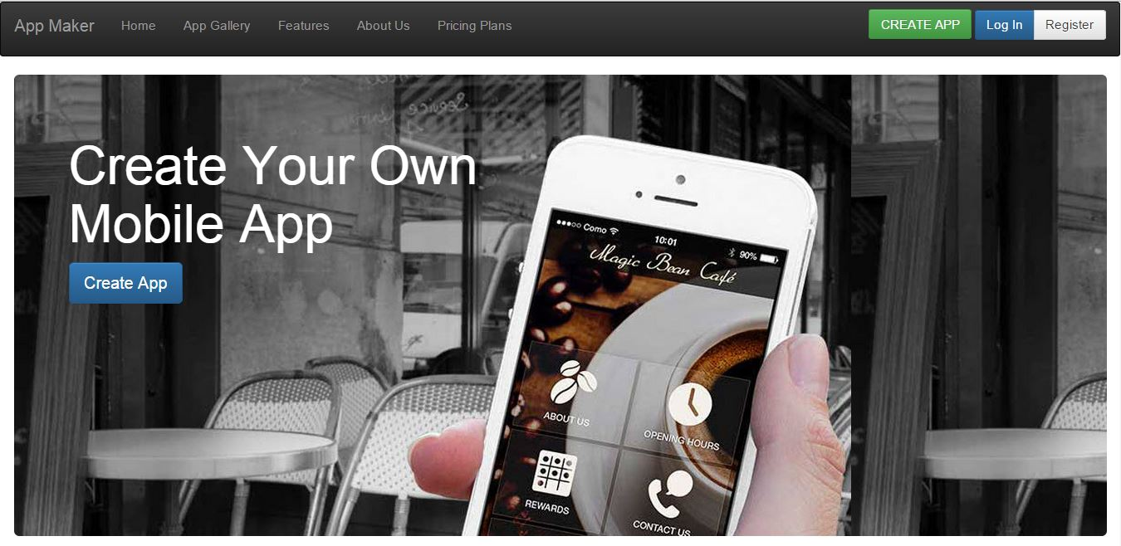
SCREEN SHOTS
User Home

Slide 48
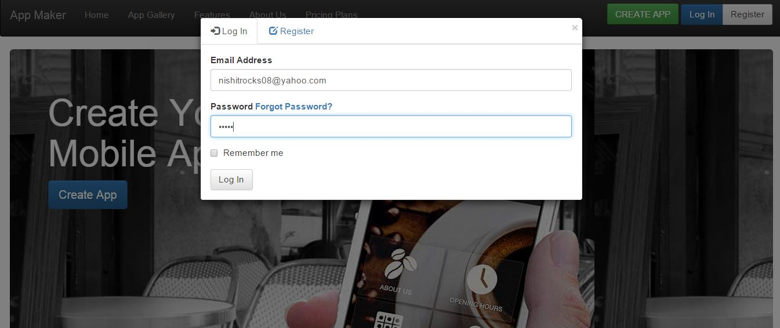
Login

Slide 49
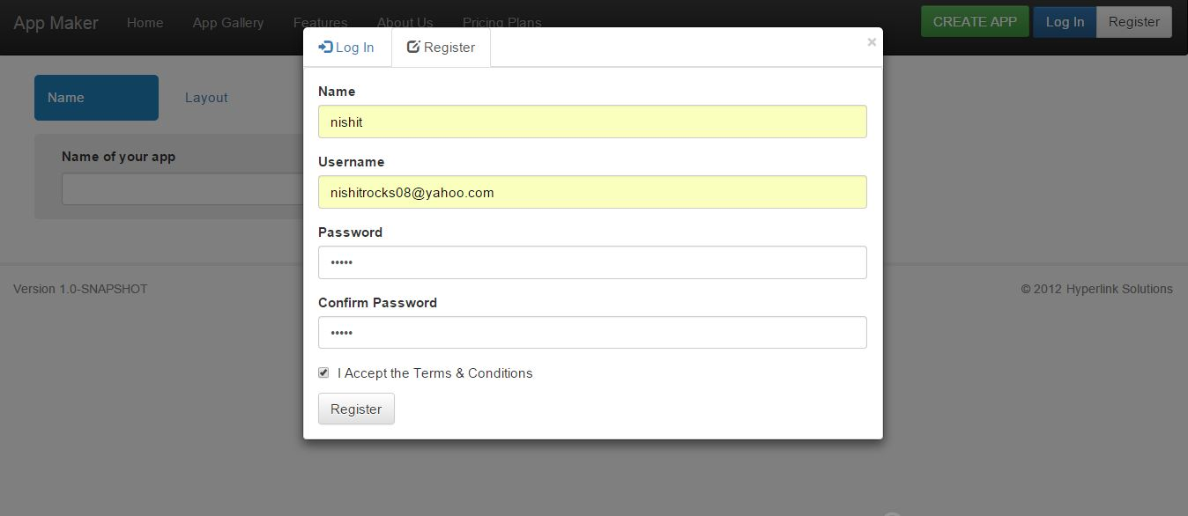
Registration

Slide 50
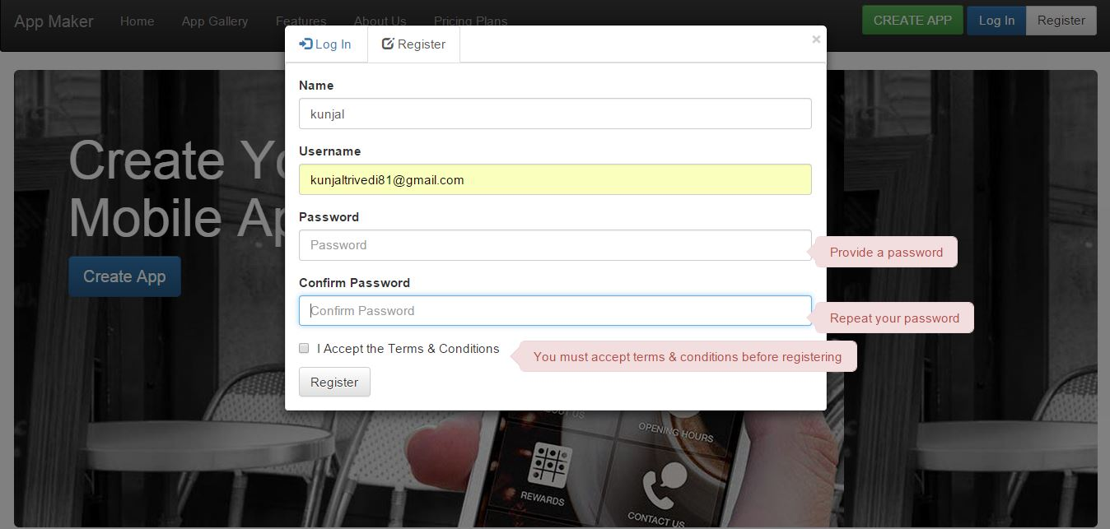
Registration with validation

Slide 51
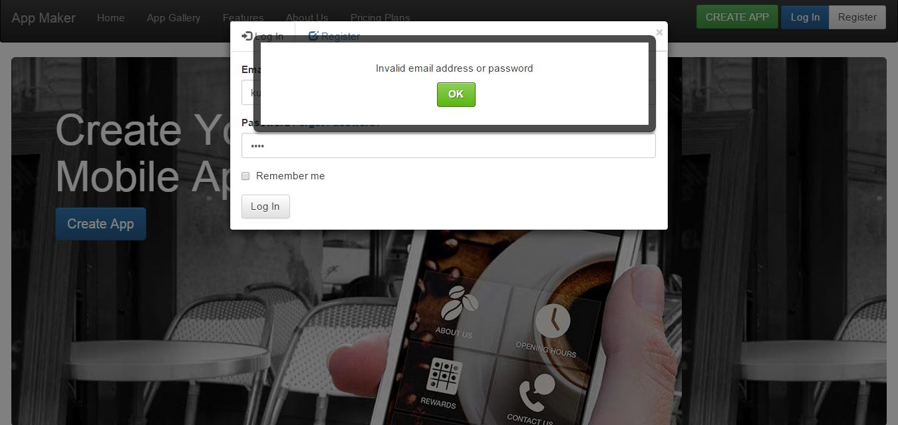
Alert on invalid login

Slide 52
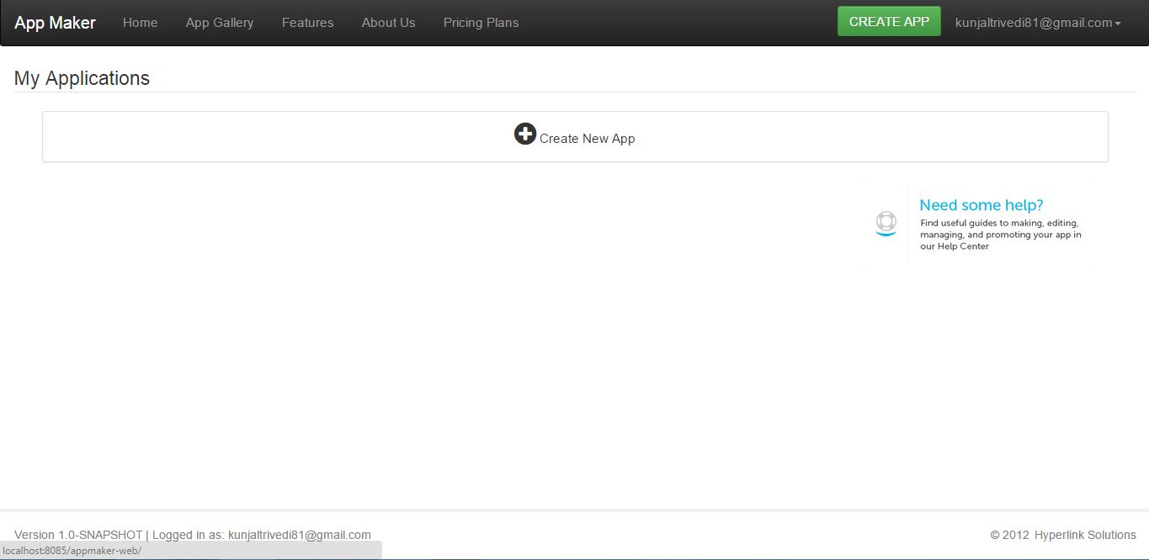
User screen After Login

Slide 53
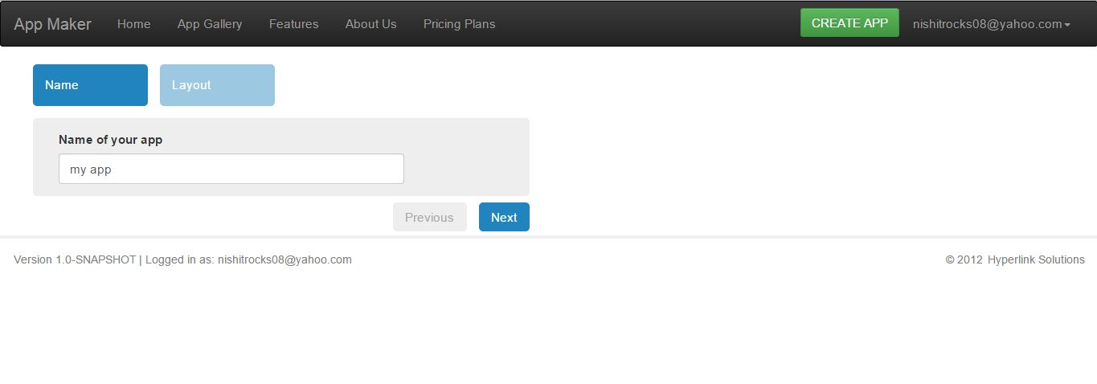
Naming Application

Slide 54
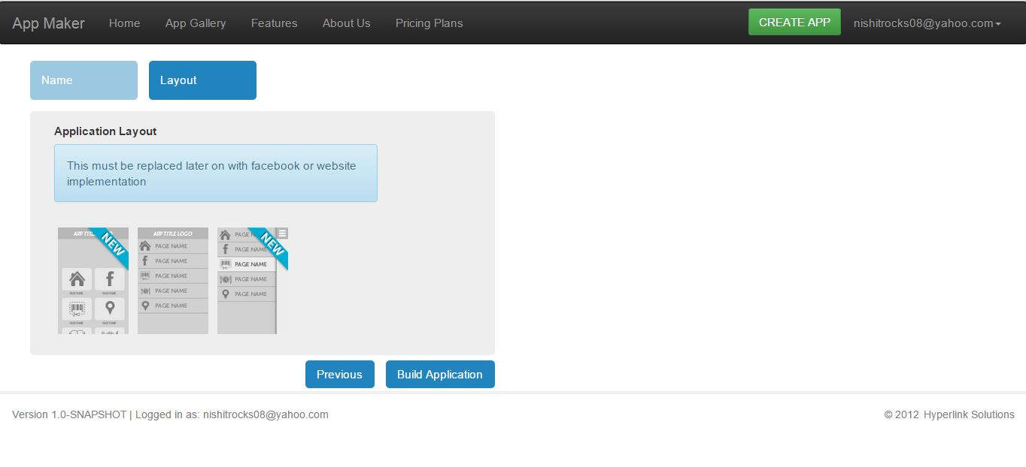
Selection of layout

Slide 55
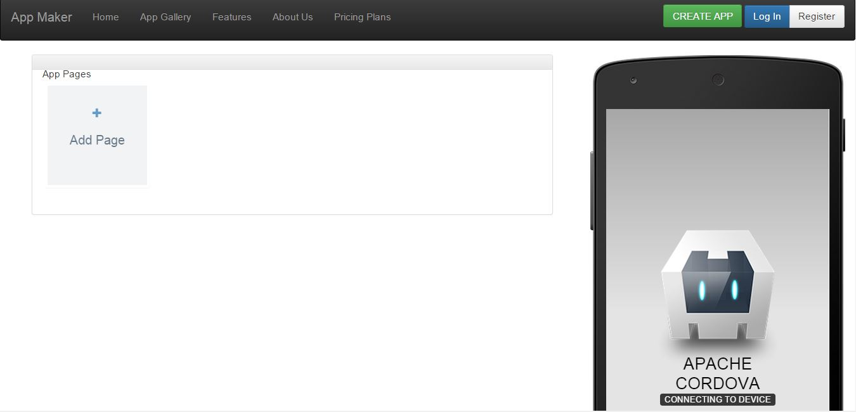
Create App Page

Slide 56
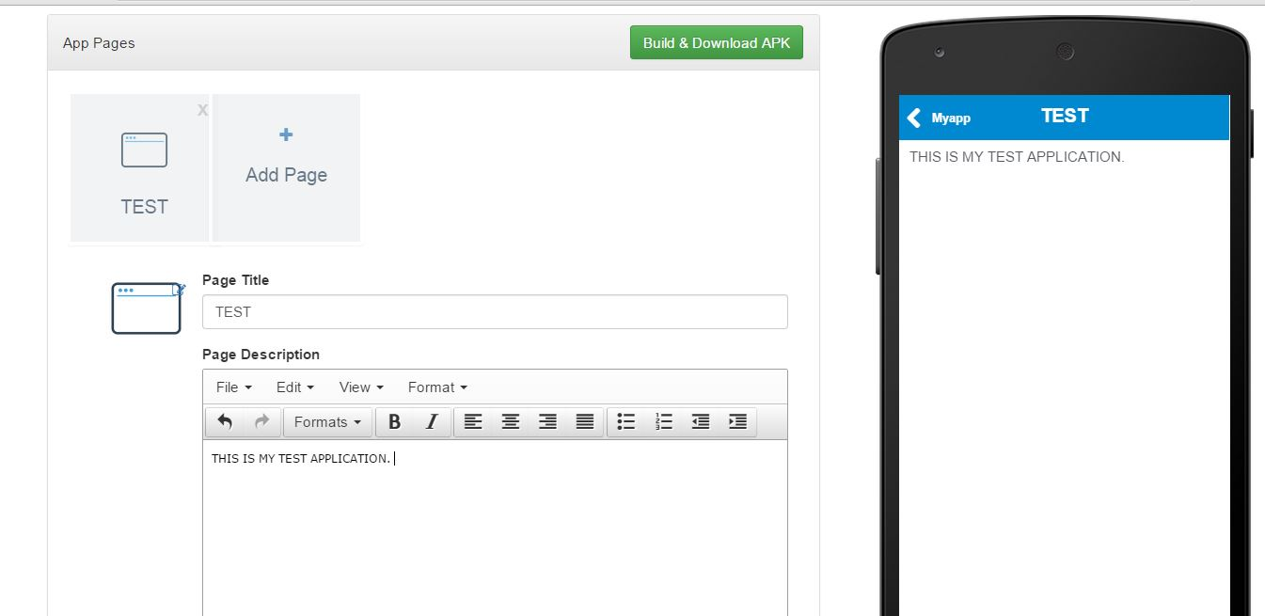
App page 1

Slide 57
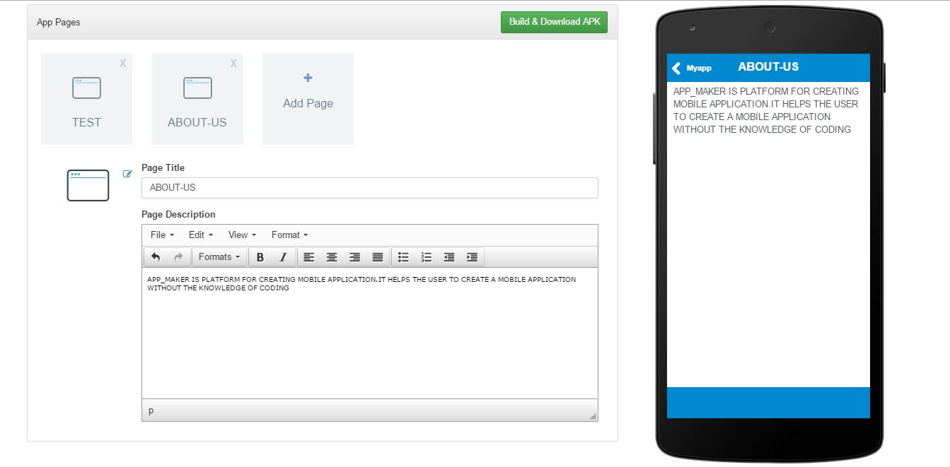
App Page 2

Slide 58
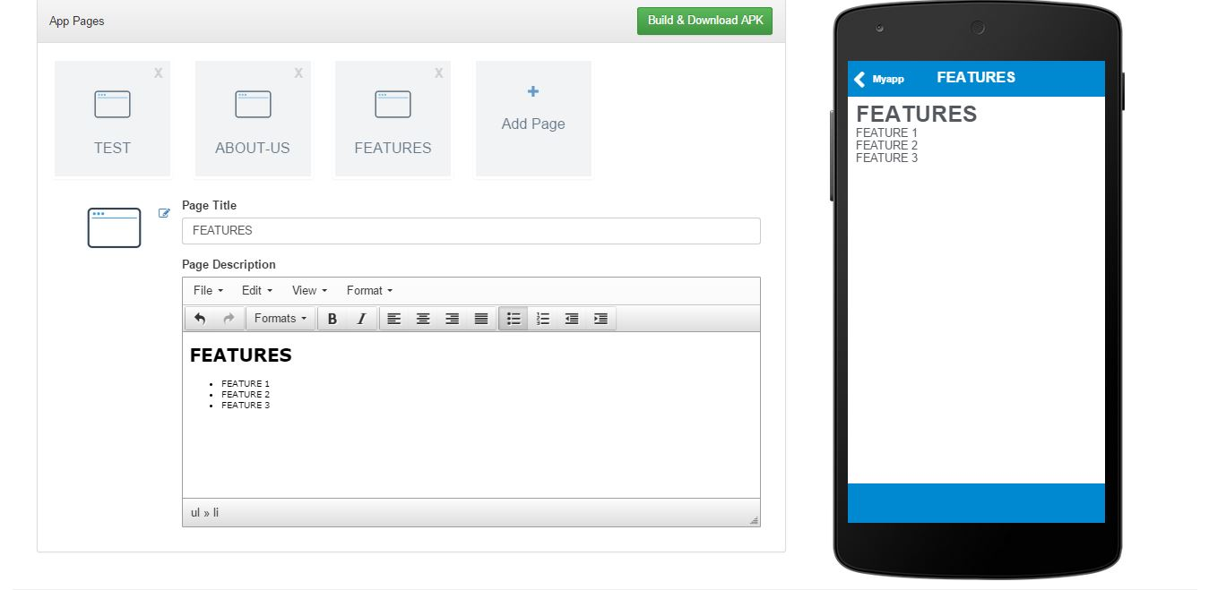
App Page 3

Slide 59
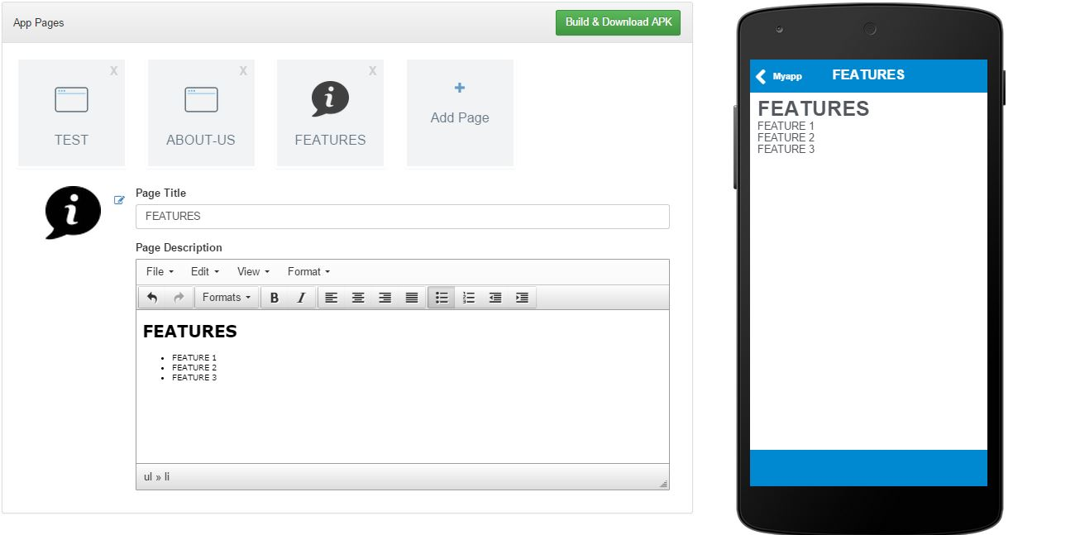
App Page 4

Slide 60
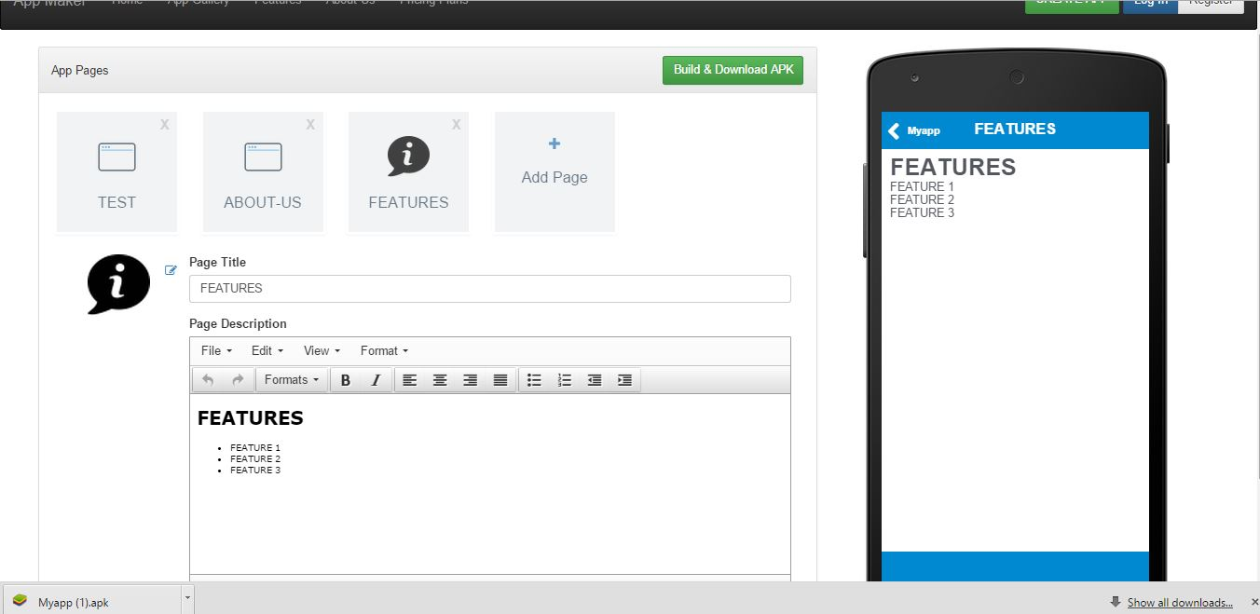
App Page 5

Slide 61
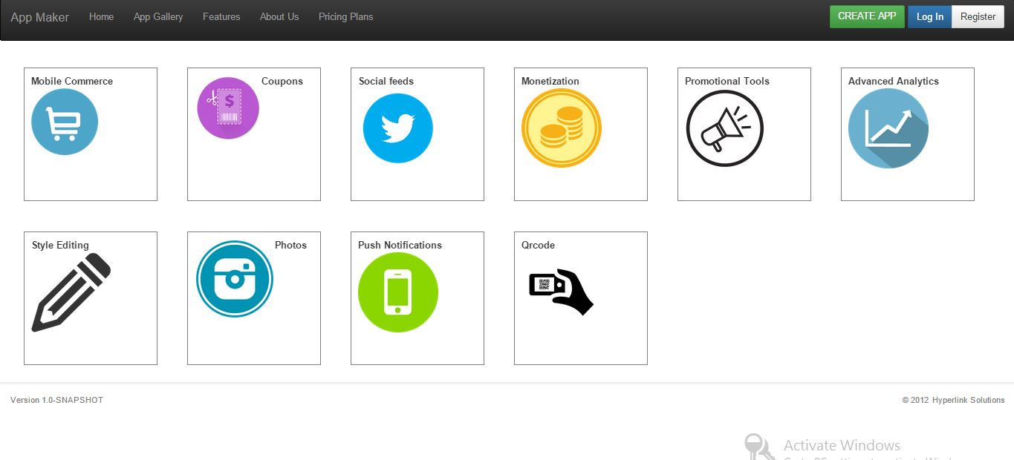
Features

Slide 62
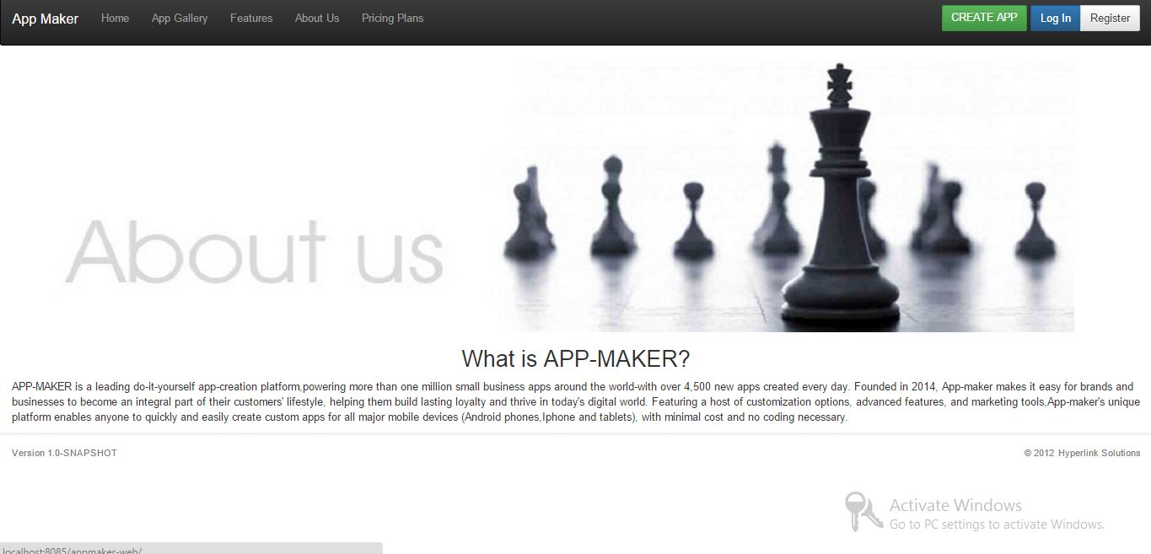
About us

Slide 63
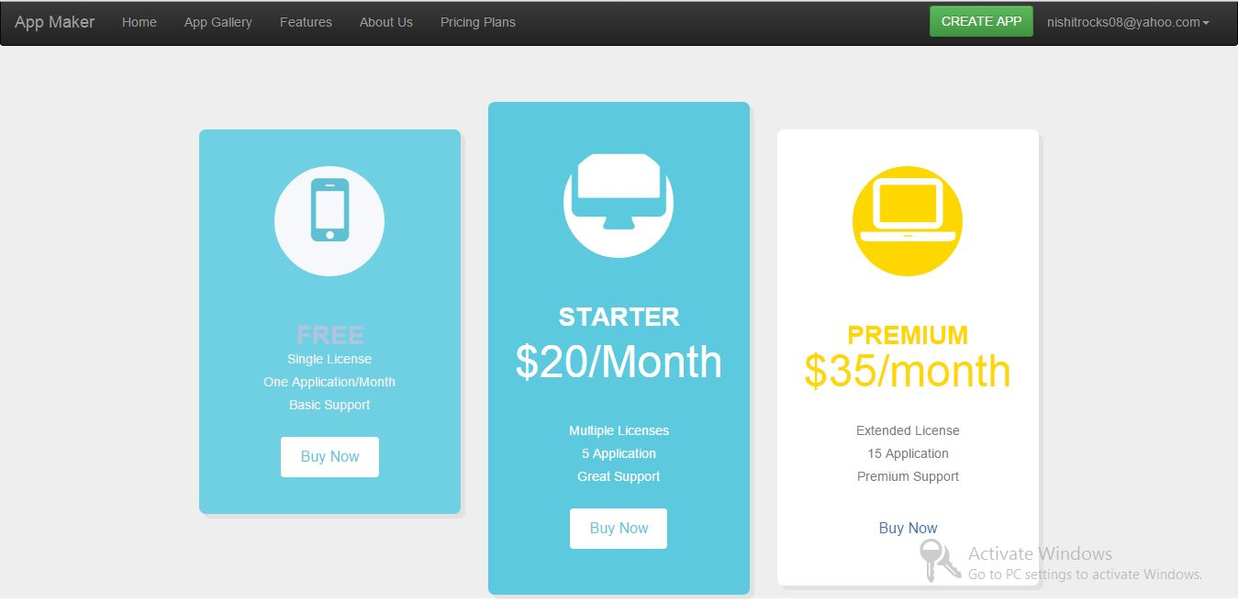
Pricing Plans

Slide 64
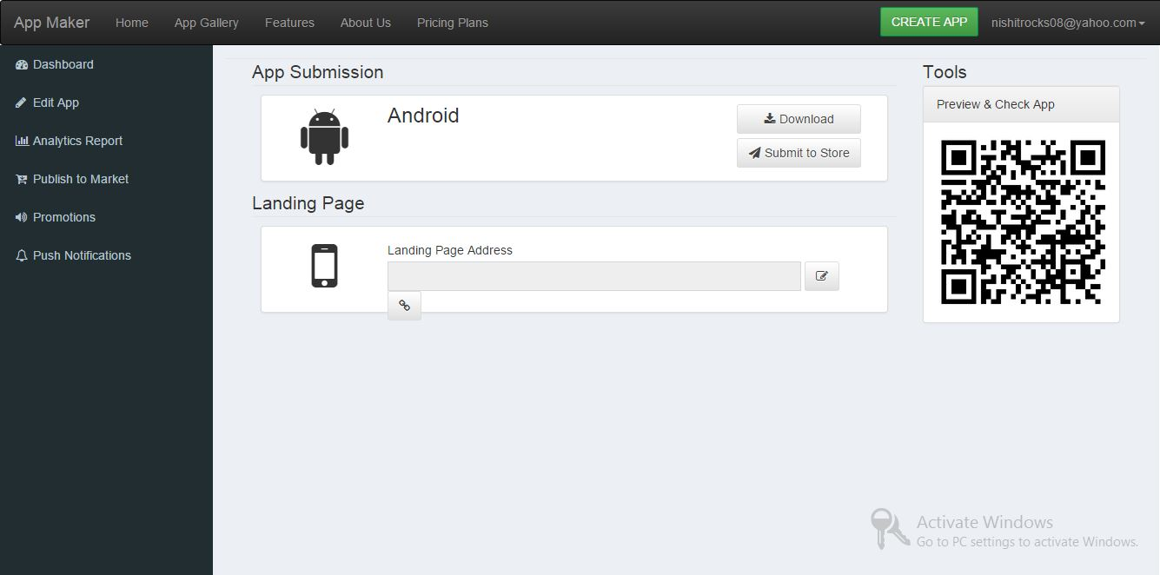
Application Dashboard

Slide 65
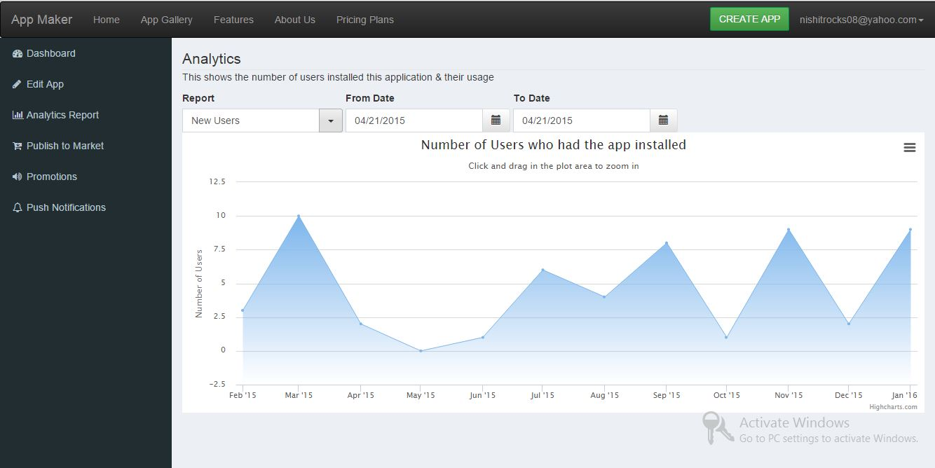

Analytical Report

Slide 66
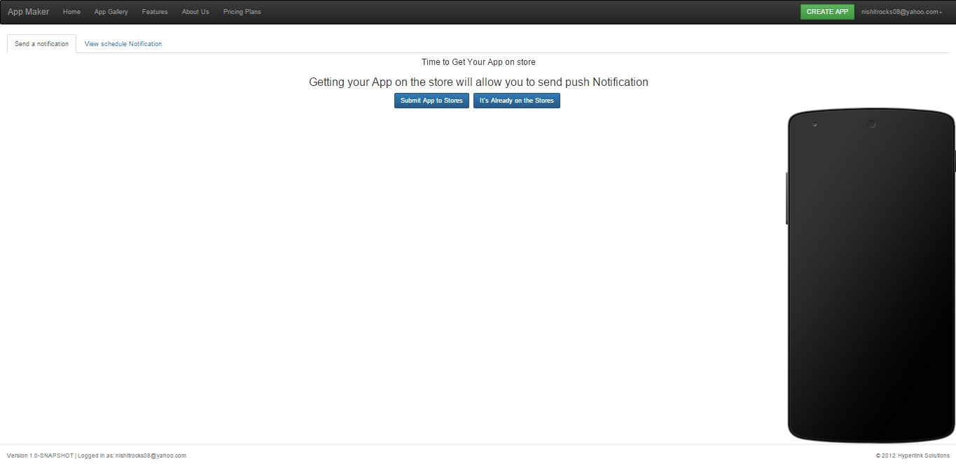
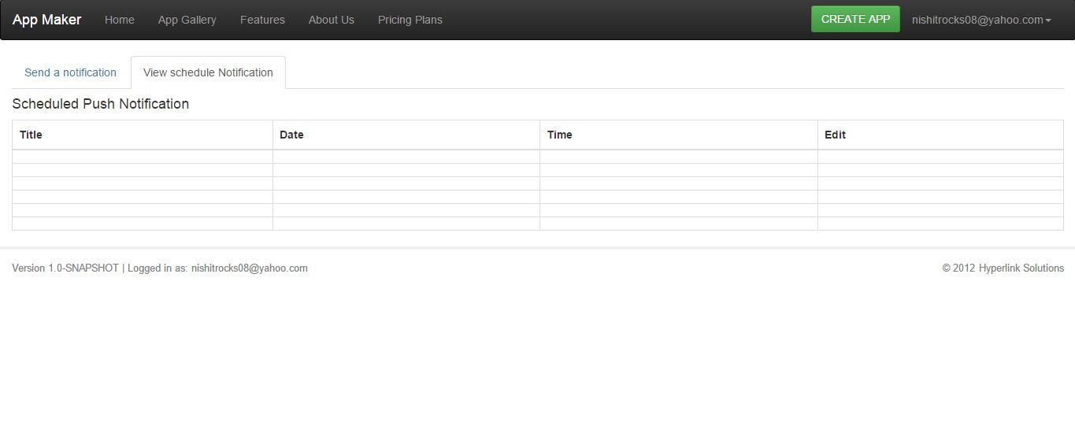
Push Notification

Slide 67
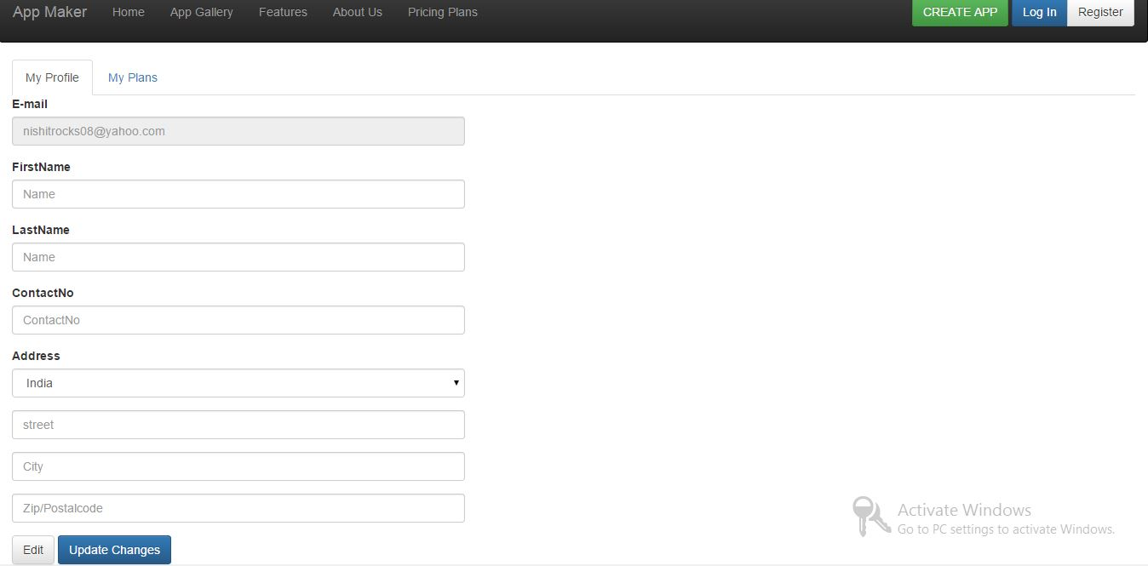
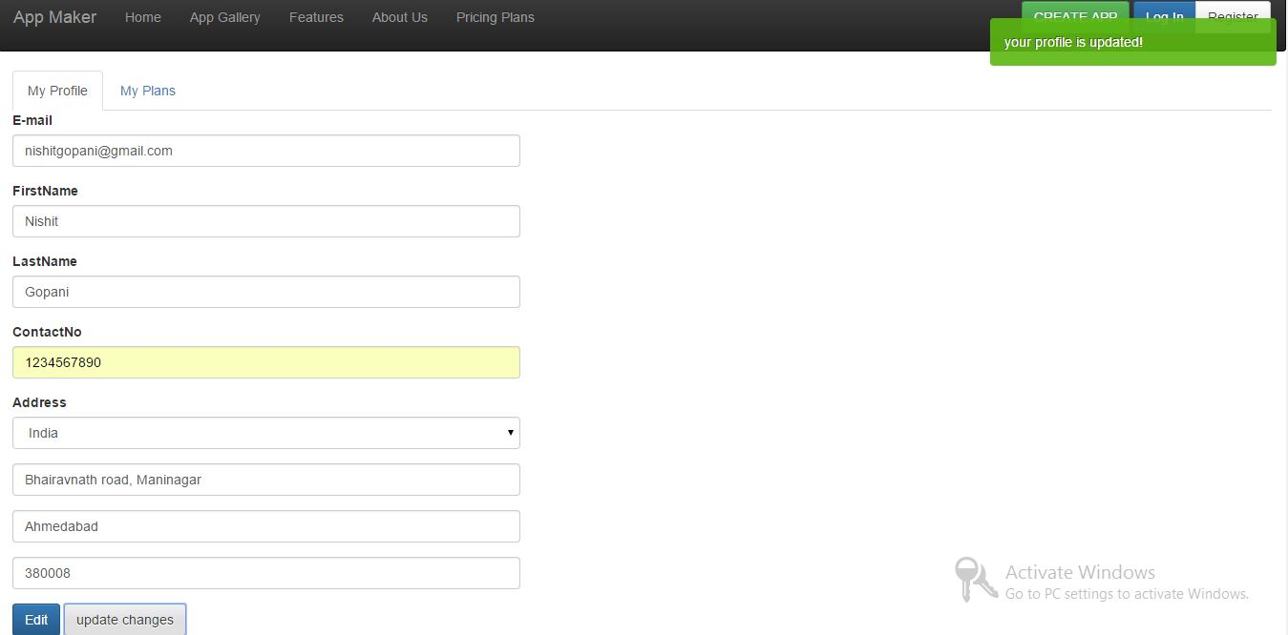
Edit/Update Profile

Slide 68
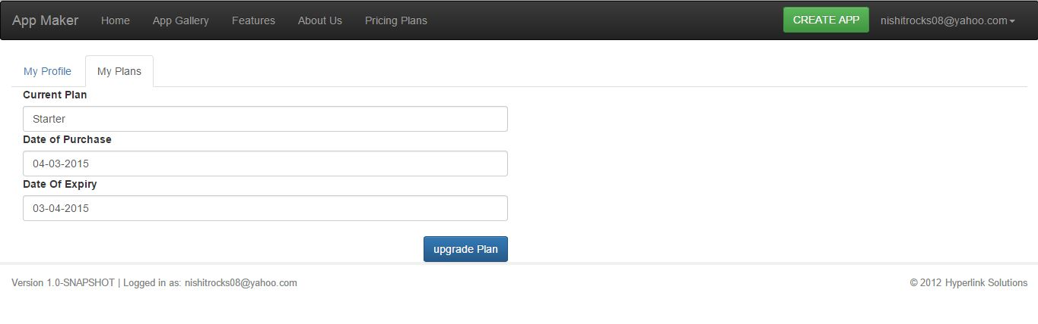
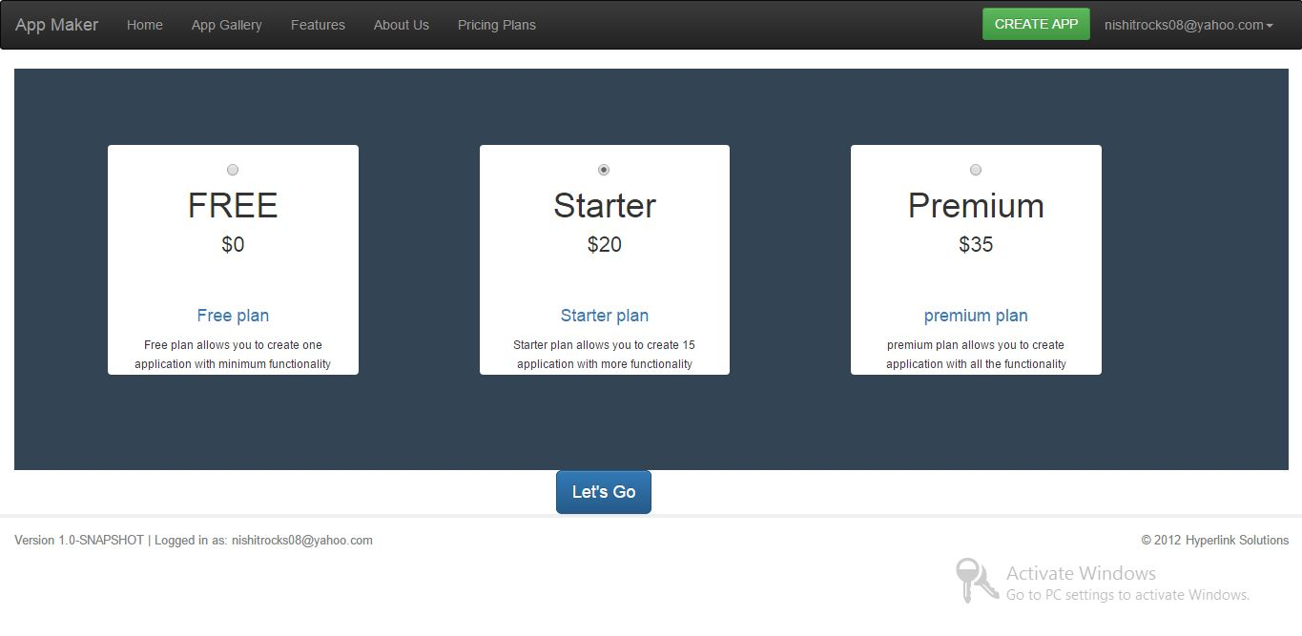
User Plan/Upgrade plan

Slide 69
Admin Login
Admin Module

Slide 70
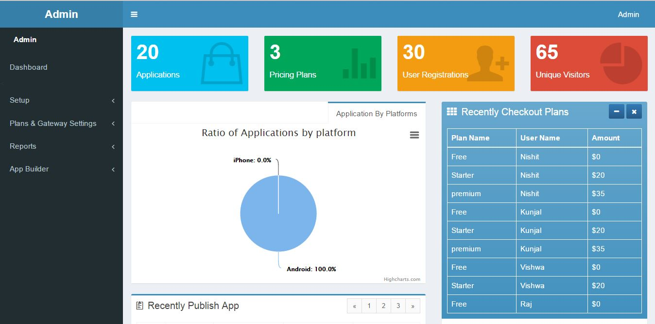
Admin Home

Slide 71
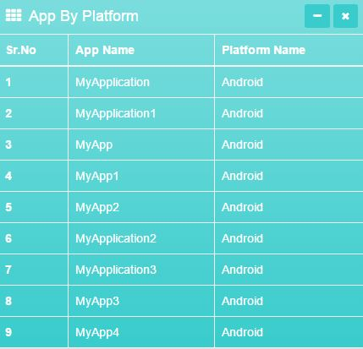
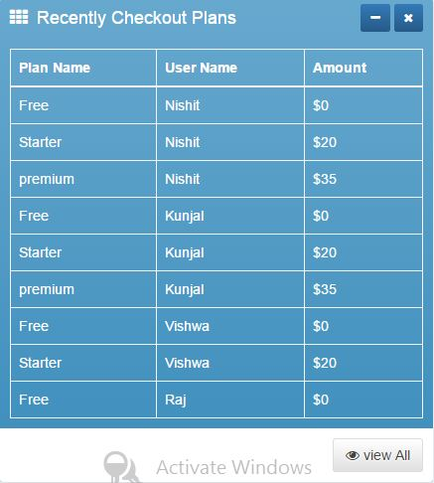
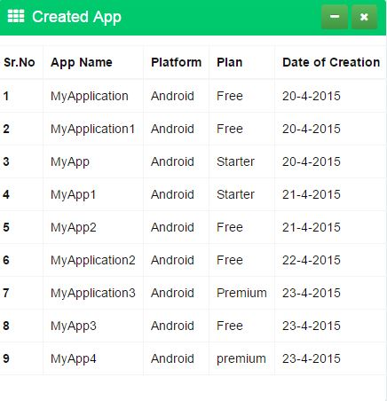
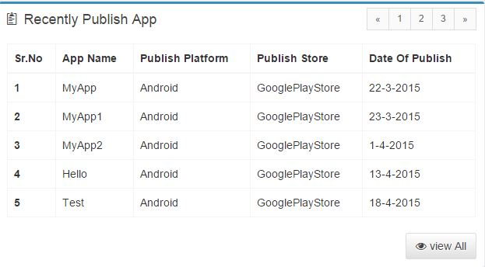
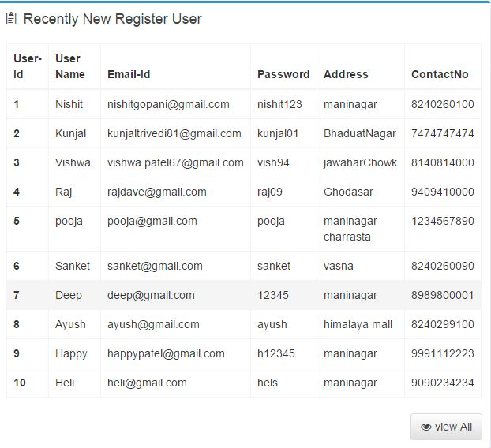
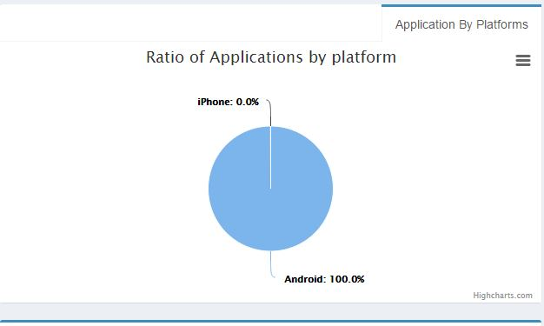
Charts/Tables

Slide 72
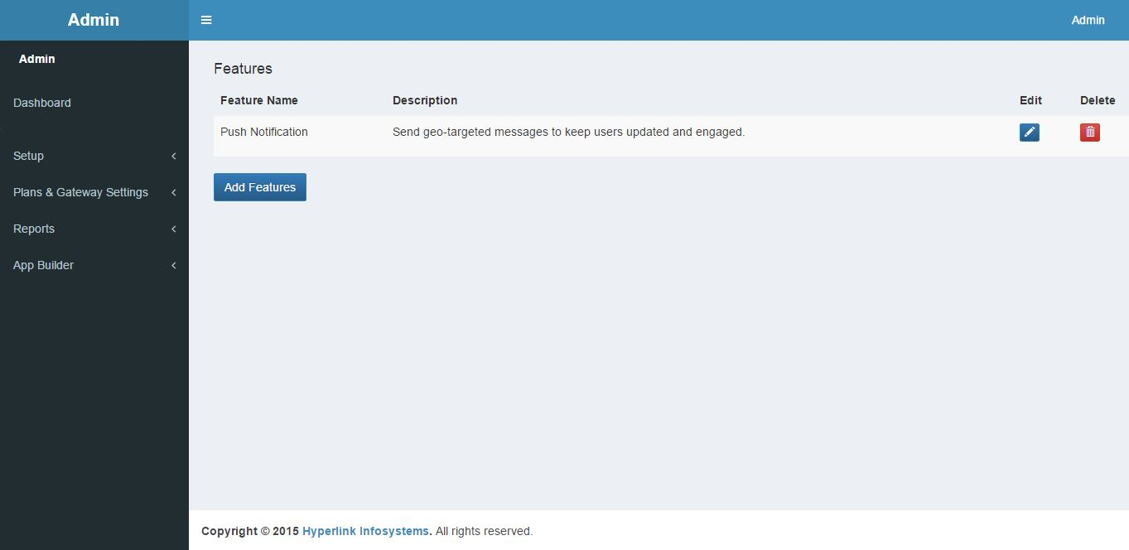
Manage Features

Slide 73
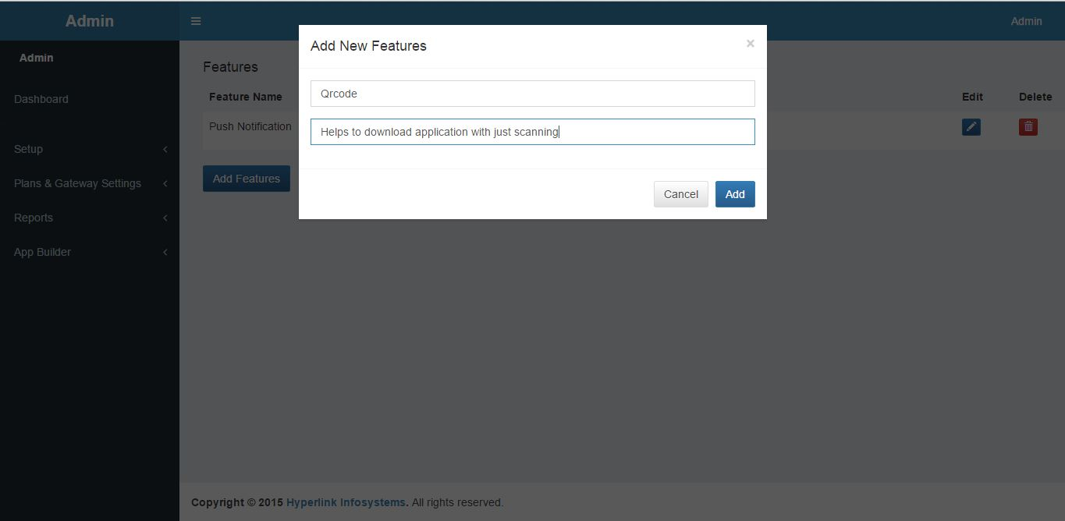
Add New Features

Slide 74
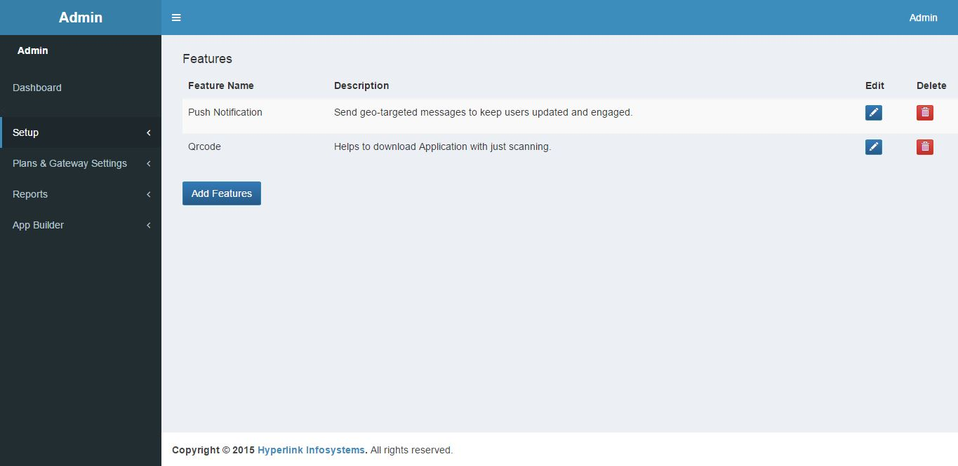
Feature Added

Slide 75
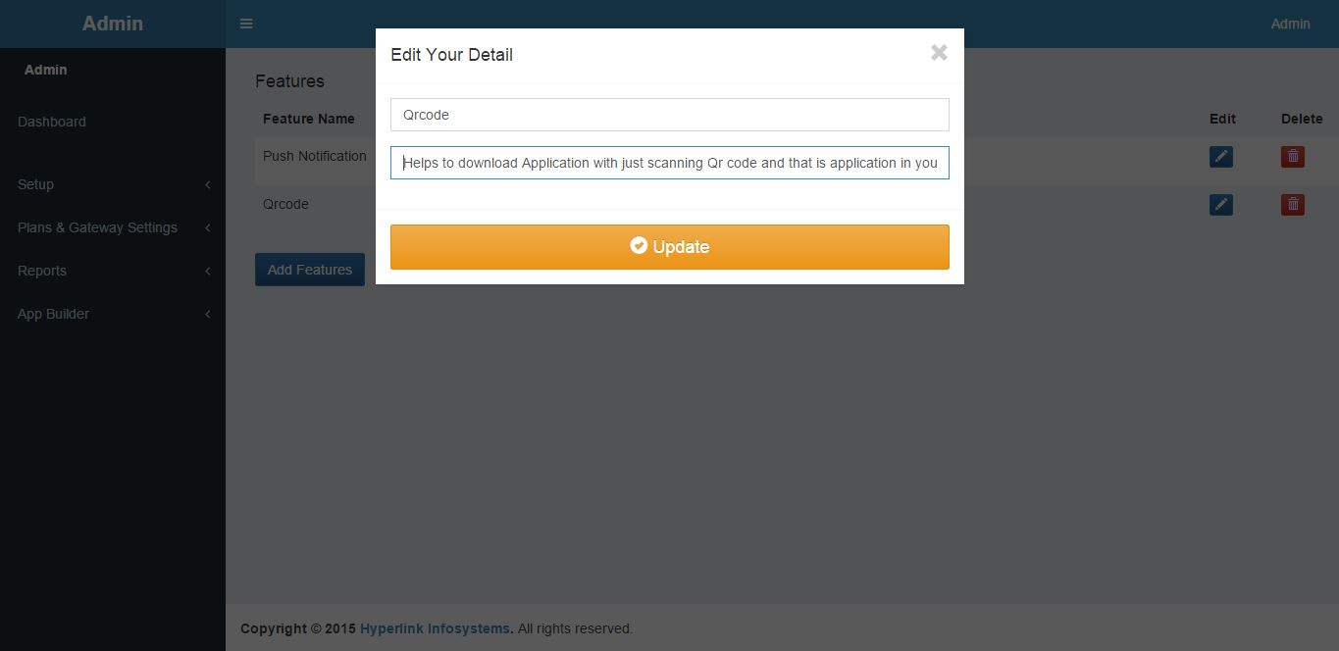

Edit Features/Updated Features

Slide 76


Delete Features/Updated Feature

Slide 77

Manage Platform

Slide 78


Edit/Updated Platform

Slide 79


Add Platform/Updated Platform

Slide 80

Delete Platform/Updated Platform

Slide 81


Manage Payment Gateway/Manage Pricing Plan

Slide 82

User Report

Slide 83

Apps Report

Slide 84

User wise App Report

Slide 85

User Payment Report

Slide 86
Conclusion
The main drawbacks of existing websites led us to develop a user friendly website App-maker.
Most problems would be solved and the expectations of the current users of these sites would be satisfied through App-maker as it will provide rich UI, Promotional tools, Multiple platform and other such exciting and new features.
Thus, as a solution to the problems mentioned above, a website App-maker is being developed by us.

Slide 87
Future Work
This system will try to implement following in future:
Providing advertisement and coupons in the mobile application.
Changes in IOS or to implement smoothly in Macintosh.
Try to integrate content of website/facebook by just pasting url into mobile application.
Try to implement on windows platform.
Will integrate paypal as our Payment Gateway

Slide 88
REFERENCES
1] Michael R Blaha, James R Rumbaugh, Object Oriented Modelling and Design with UML, 2nd
Edition, Pearson Publication, 2011.
[2] Roger S. Pressman, Software engineering, McGraw-Hill, 2001
[3] M.T Savaliya and Kogent Learning Solutions, Advance Java Technology, Dreamtech
press, 2012
[4] (2013) The GOOGLE website. [Online]. Available: http://www.google.com
[5] (2009-2012) The JAVA website. [Online]. Available: http://www.java2s.com
[6] (2011) The Java Tutorial website. [Online]. Available: http://www.roseindia.net
[7] (1999-2013) The Online Tutorial website. [Online]. Available: http://www.w3schools.com
[8]App-Builder. [Online]. Available: http://www.App-builder.com
[9] Como. [Online]. Available: http://www.como.com
[10] Appery.io.com website. [Online]. Available: http://www. Appery.io.com.com
[11] Rajib Mall, Fundamentals of Software engineering, 3rd Edition, PHI Learning Pvt. Ltd

Slide 89
Thank you...!!!

